Slide 1
Revature Bank
Project 0
Author: Brandon Vitayanuvatti

Slide 2
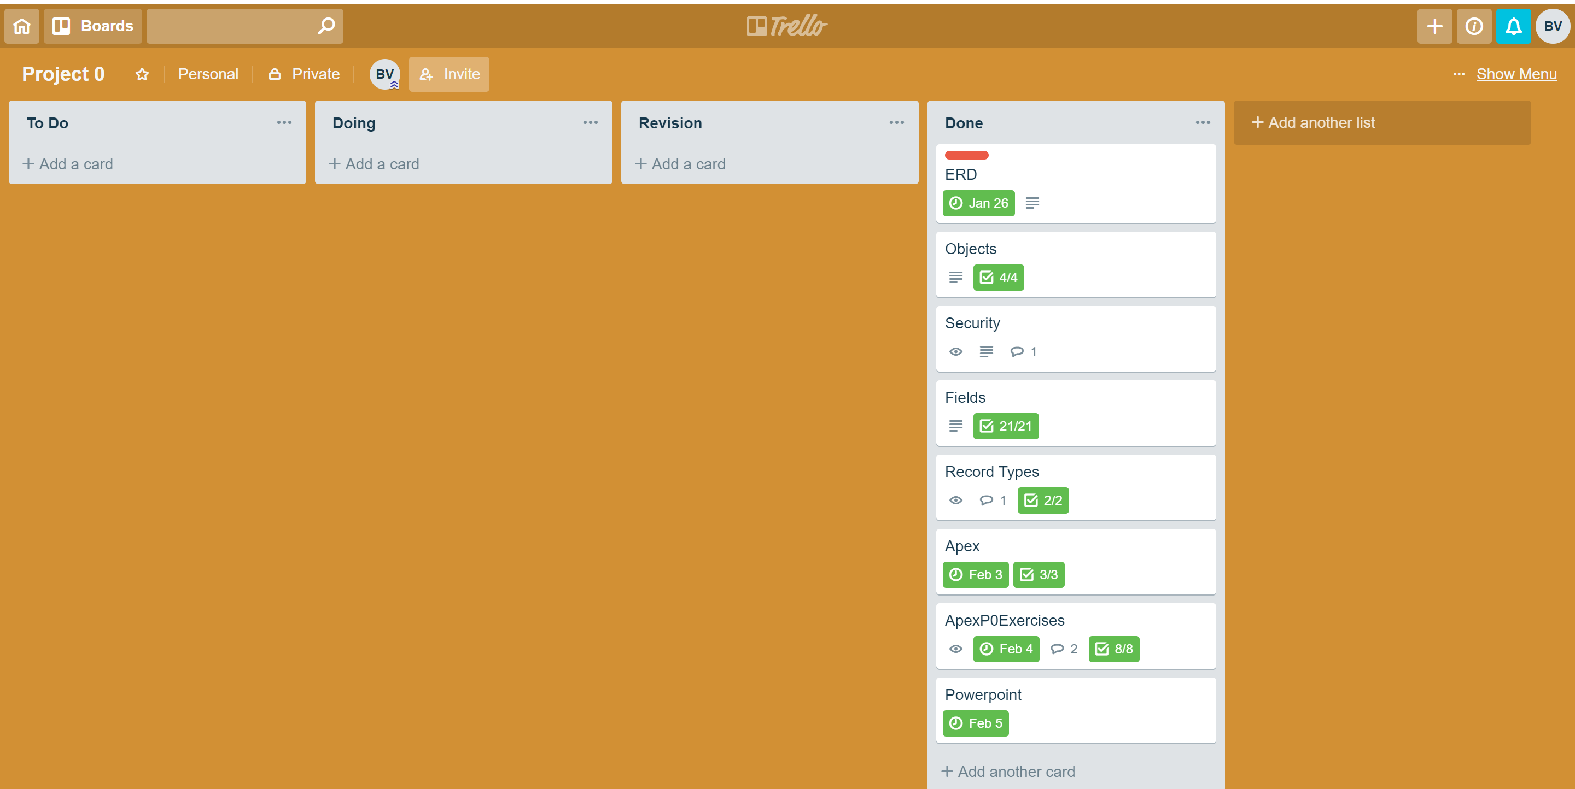
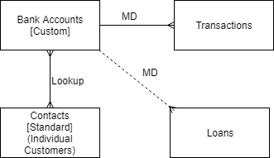
Overview

Slide 3
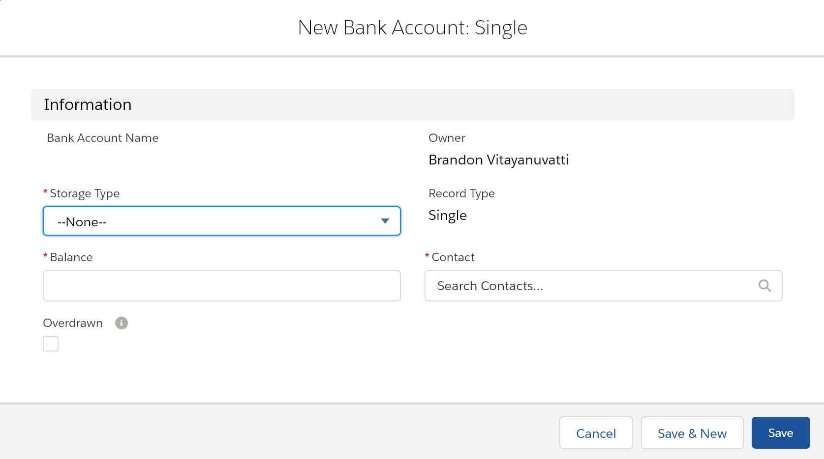
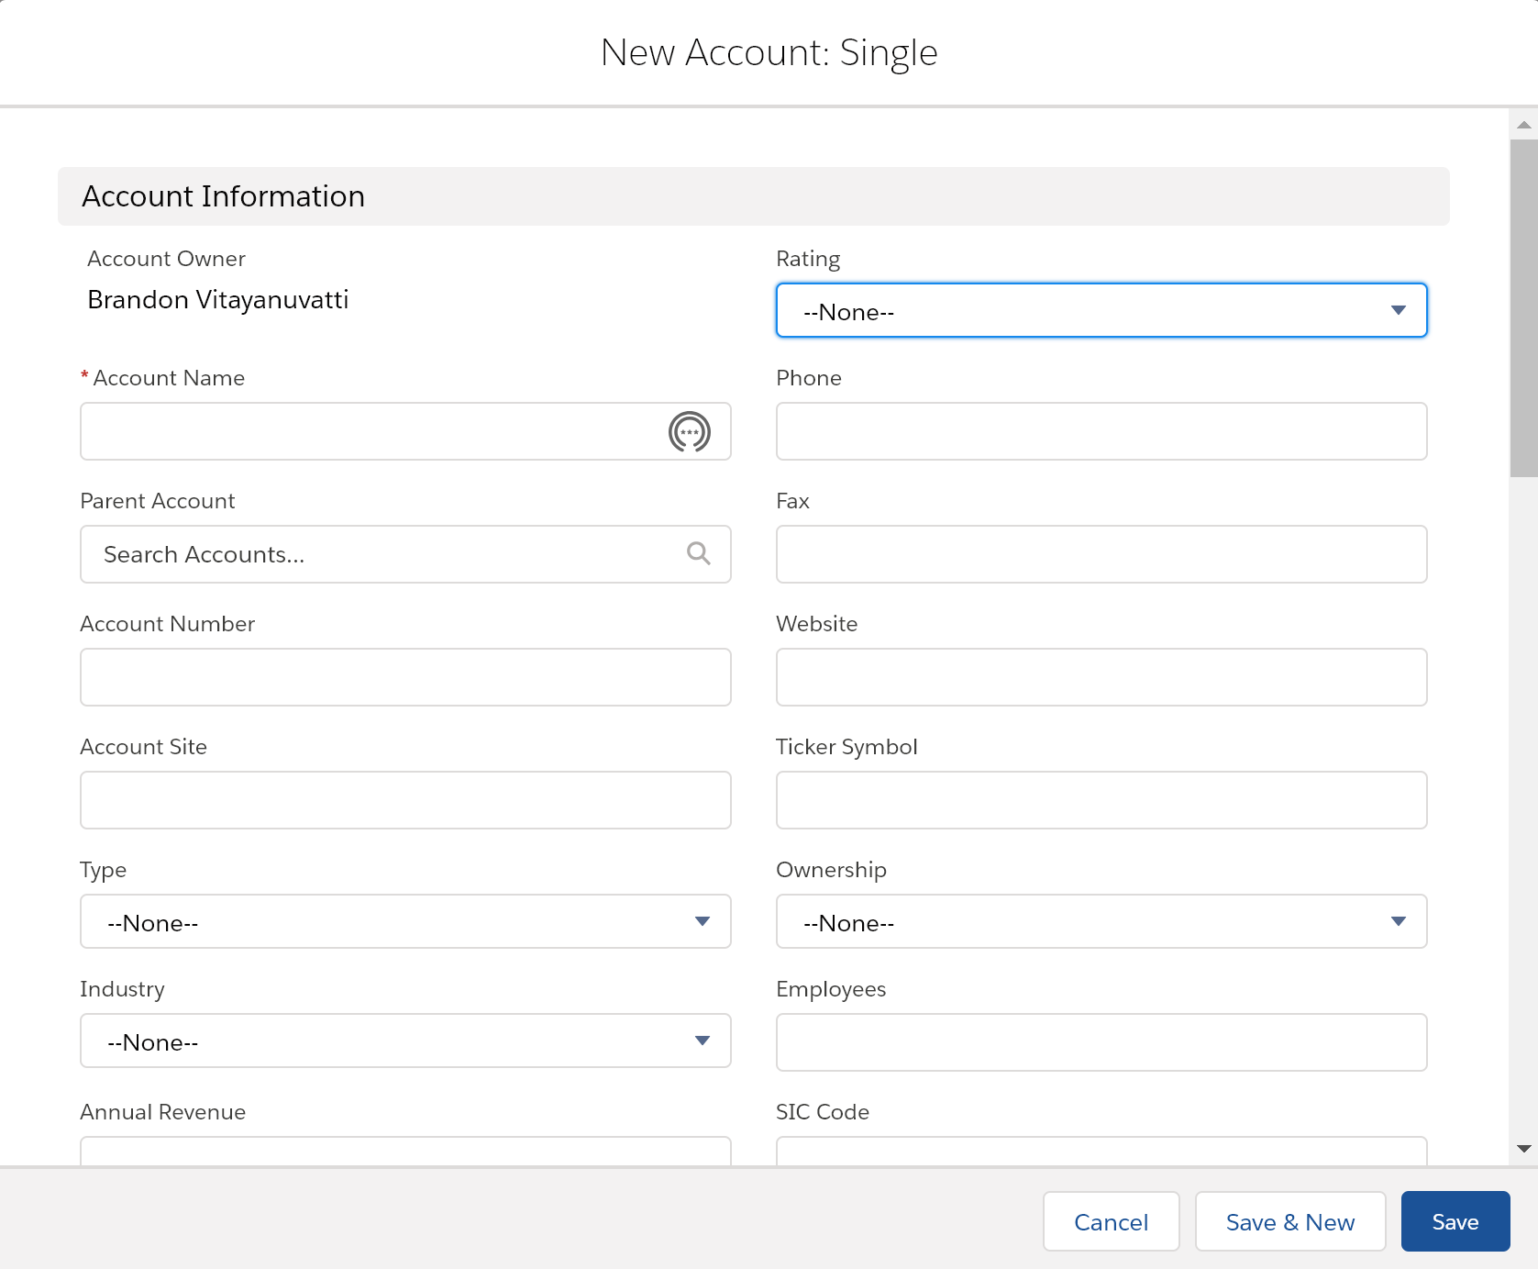
Bank Accounts
Not Business to Business
Business to Consumer
Single
Joint
Auto-Number
BA-##########

Slide 4
Security
Types of Users
System Administrator
Loan Officer
Teller
Financial Consultant
Settings
Read Only
Login Hours
Access through Profiles
Teller
Loan Officer

Slide 5
